Slide 1
House Price Prediction
House prices in Australia

Slide 2
GOAL
To create a ML model that predicts the house price in Australia

Slide 3
DATA
We are provided with train and test CSV files
Train dataset contains 1168 rows
The dataset consist of 81 columns including the price

Slide 4
PREPROCESSING
Dropped columns Alley,MiscFeature, PoolQC, Fence because there were null values more than 80%
Dropped Utility column since it has only one unique value

Slide 5
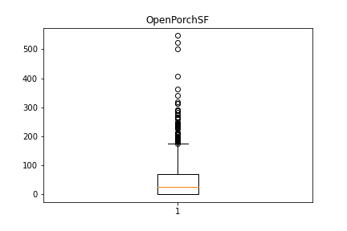
OUTLIERS
Boxplotted all numeric columns to get outliers

Slide 6
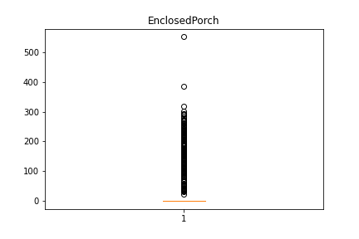
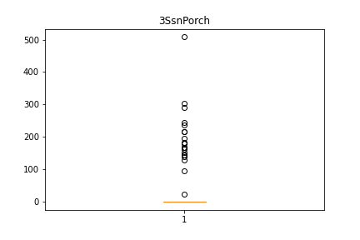
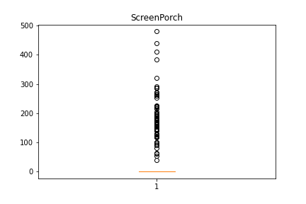
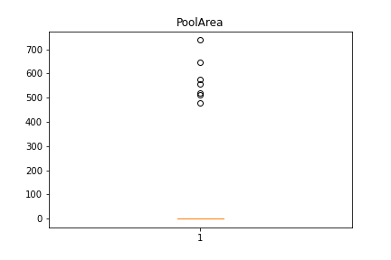

Slide 7
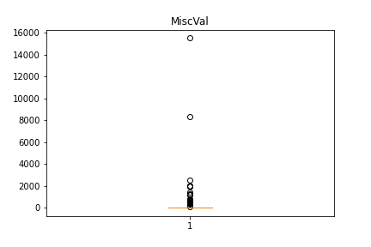
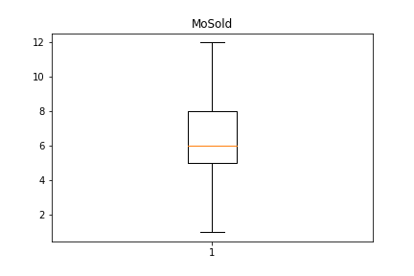
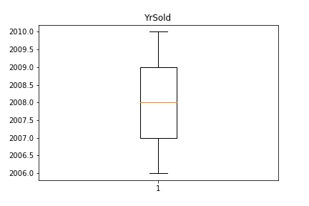
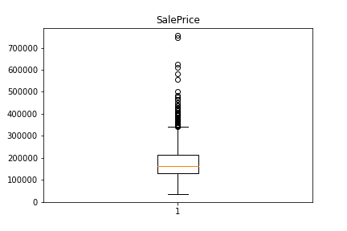

Slide 8
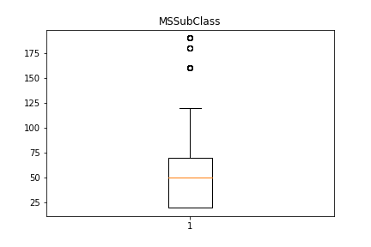
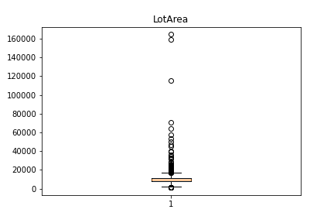
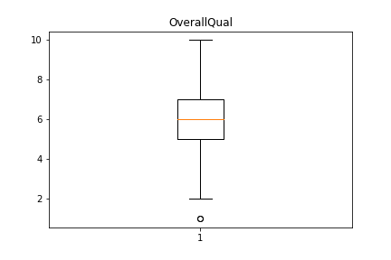
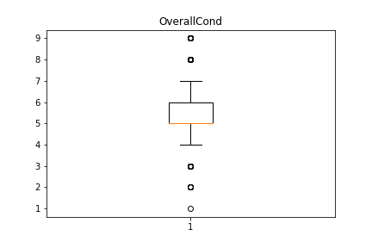

Slide 9
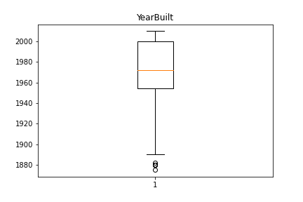
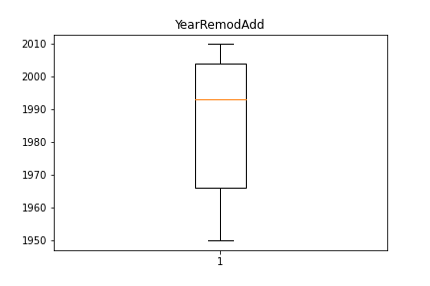
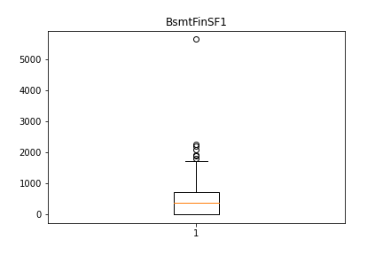
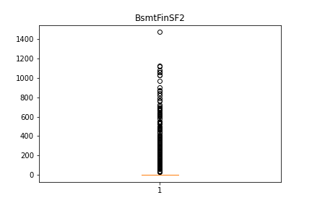

Slide 10
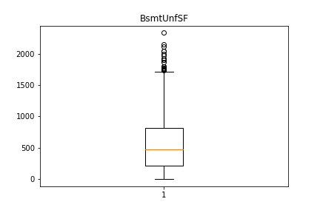
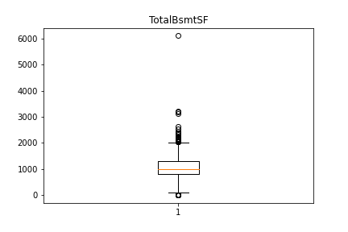
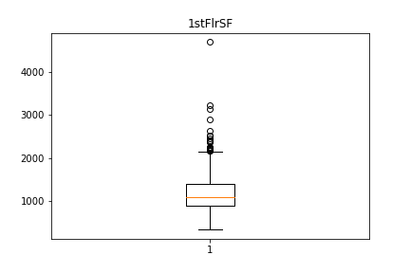
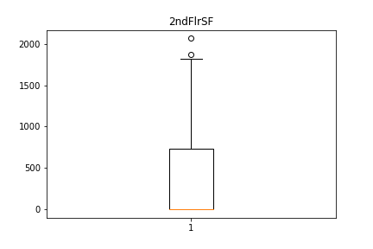

Slide 11
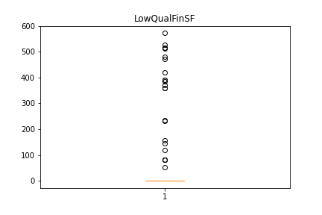
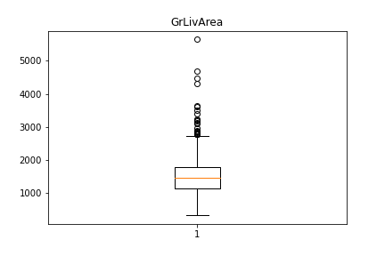
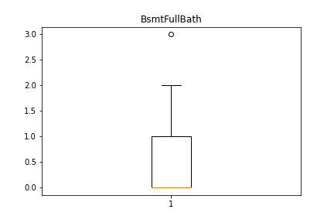
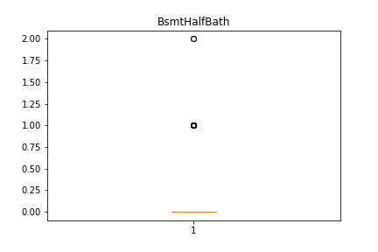

Slide 12
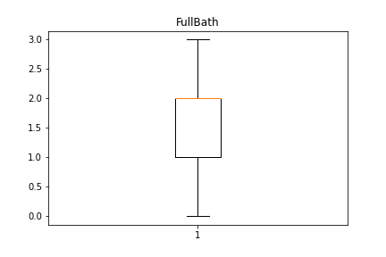
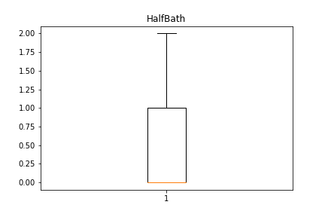
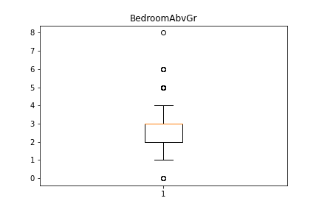
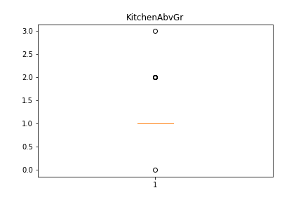

Slide 13
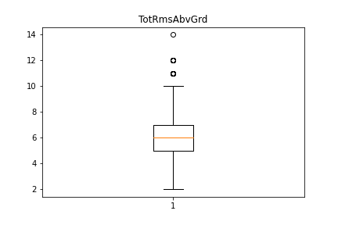
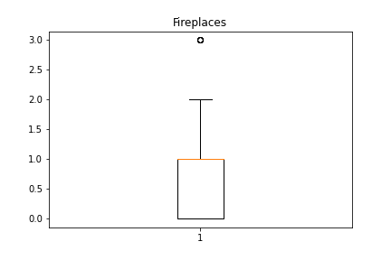
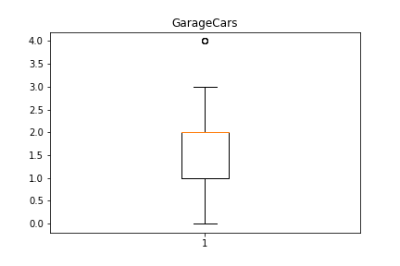
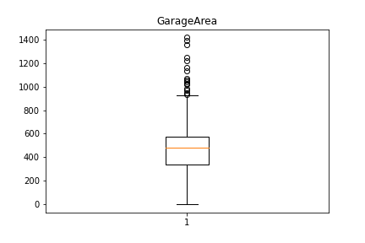

Slide 14
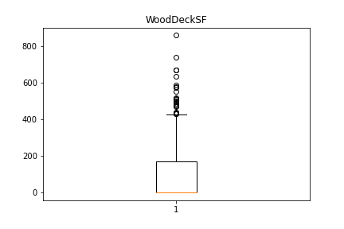

Slide 15
Replace the outliers with NaN values
#replace the outlier values with nan values
for column in train.columns:
if train[column].dtype != "object":
if column != "SalePrice":
ul, ll = out_limits(train[column])
train[column] = np.where((train[column] > ul)|(train[column] < ll), np.nan, train[column])

Slide 16
Replaced the NaN values with the median and mode
#replacing nan values with median and mode
for column in train.columns:
if train[column].dtype != "object":
train[column].replace(np.nan, train[column].median(), inplace=True)
else:
train[column].replace(np.nan, train[column].mode(), inplace=True)

Slide 17
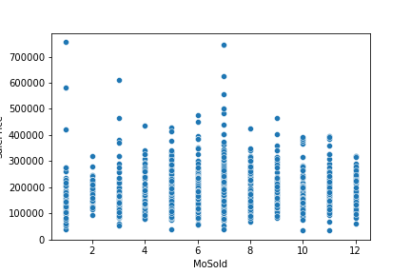
Scatterplots

Slide 18
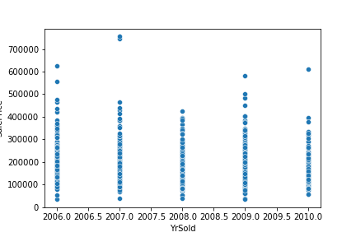
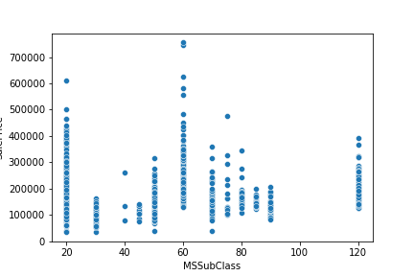
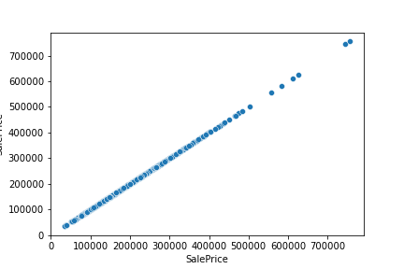
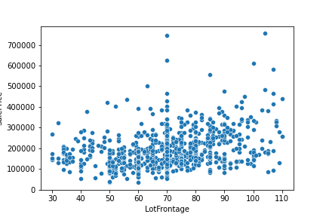

Slide 19
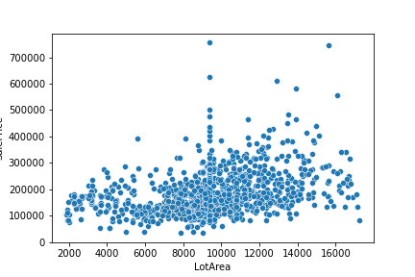
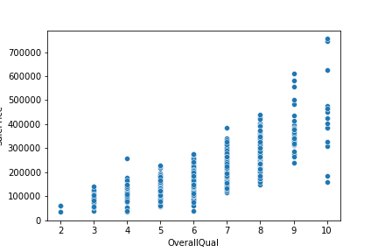
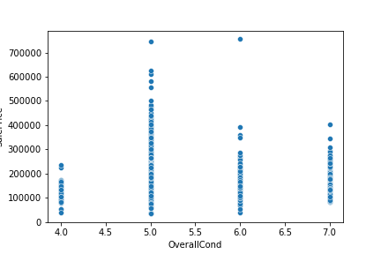
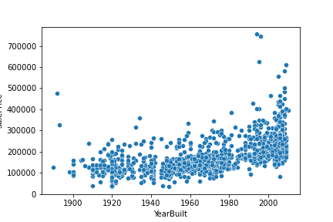

Slide 20
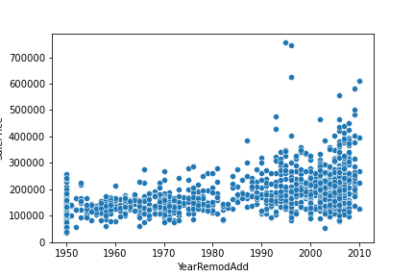
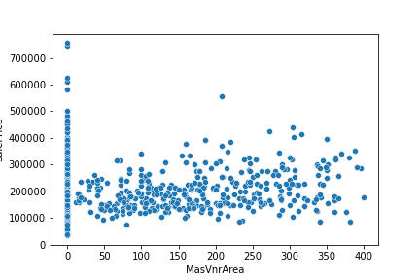
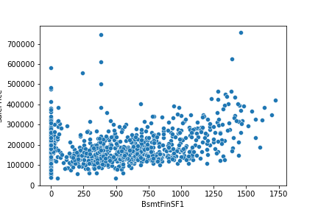
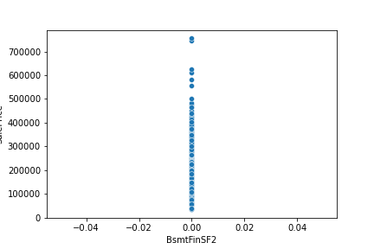

Slide 21
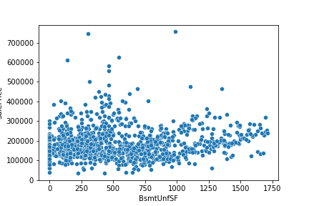
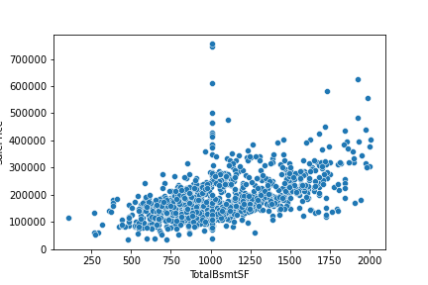
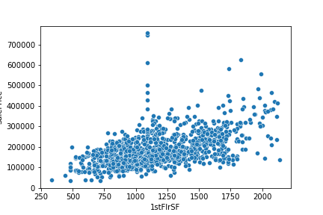


Slide 22





Slide 23





Slide 24





Slide 25


Slide 26
Skewness
Found skewness in the following column
MSSubClass
OverallCond
MasVnrArea
BsmtFinSF1
BsmtUnfSF
2ndFlrSF
HalfBath
GarageYrBlt
WoodDeckSF

Slide 27

Distplots

Slide 28





Slide 29





Slide 30





Slide 31





Slide 32





Slide 33





Slide 34




Slide 35

Correlation values

Slide 36

Countplots

Slide 37





Slide 38





Slide 39





Slide 40





Slide 41





Slide 42





Slide 43





Slide 44





Slide 45





Slide 46


Slide 47
Feature Engineering
Created three new columns from the year columns
train["builtTosale"] = train["YrSold"] - train["YearBuilt"]
train["modiTosale"] = train["YrSold"] - train["YearRemodAdd"]
train["garageTosale"] = train["YrSold"] - train["GarageYrBlt"]

Slide 48
Observations
In sub class, Price decrease with increase in value within sub division of sub class(in the base of stories and styles)
Lot Fontage has no direct relationship with price. It might have dependent with other features
Price increases with overall quality
In over all condition, Price is higher in the middle range
Year built is approximately +ve correlated with price, but we have to check with other parameters too
BsmtFinSF2 column has only 1 value which is zero. so we can drop that

Slide 49
Other basement area(sq ft) related features is almost directly propotional to saleprice
Floor squre feet is + correlated with sale price
LowQualFinSF column has only 1 value which is zero. so we can drop that
BsmtHalfBath,kitchenabvgr,EnclosedPorch,3ssnporch, screenporch,poolarea,miscval columns have only 1 value which is zero. so we can drop that
GrLivArea is directly correlated with price
FullBath, BedroomAbvgr,fireplaces, GarageYrBlt,GarageCars is directly correlated with price
columns MSSubClass, OverallQual, OverallCond, BsmtFullBath, Fullbath, HalfBath, BedroomAbvGr, TotRmsAbvGrd, FirePlaces, GarageCars, MoSols, YrSold can be treated as categorical values

Slide 50
All skewed column except OverallCond are poorly correlated with sales price. So we can convert to log these columns
basment full bath and basementunitsf are -vely correlated
First floor sqft and basement sqft are highly +ve correlated
Overall quality and price are highly correlated
garage car and garage area are +vely correlated

Slide 51
Price decreases from MZZoning RL to C
Houses in Paved street is more costly
Houses in flat level have more price and banked houses cost less
House price decreases with slope of the place
Typical basement houses have more price than excellent basement . So there is less over all consideration for basement

Slide 52
Houses with gas forced heating have more price
Central air conditioned houses have more price
Mixed wired houses have lesser price
Houses with attached garage have more price
Houses with paved driveway have more price

Slide 53


Slide 54
Model training
Tried SVC, KNN, Random Forest, Logistic regression and Naïve byes
KNN is found to be the most efficient model

Slide 55


Slide 56
Accuracy
By using KNN regressor, the model gained 85.5% accuracy
-------------------------------------END----------------------------------

